Slide 1




Content Creators:
Serene Williams & Kristen Kelly,
Women’s History in High School
Graphic Designer:
Gabriella Perez, High School Student
Penumbras and Comstockery
Contemporary Applications of Coverture for AP U.S. Government & Politics Students

Slide 2

Analysis of state sanctioned regulation of women’s bodies and debates over reproductive liberty offers government students a much fuller understanding of the American political system as well as competing women’s
movements

Slide 3


COVERTURE
  From English common law, paternalistic
  Woman’s civil/legal identity transferred to husband upon marriage
  Western states in 19th century
    Community property laws
  Pre-Jacksonian era
    To participate in politics, you had to own property
  Coverture banned in Planned Parenthood v. Casey (1992)
    Casey overturned in Dobbs, did it reintroduce coverture?

Slide 4

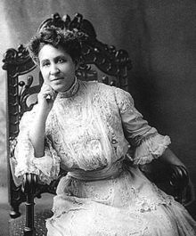

MARY CHURCH TERRELL (1863–1954)
“A white woman has only one handicap to overcome, a great one, true, her sex; a colored woman faces two—her sex and her race”

Slide 5
RESTELLISM & THE COMSTOCK LAWS
abortion
obscenity
birth control
Notes:
Start C period Friday

Slide 6



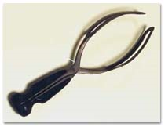
CHILDBIRTH & ABORTION IN EARLY AMERICA
  Colonial era
    Few laws, no distinction induced vs. spontaneous abortions
  Herbs
  1700s—8-9 children--1800s 4-6 children
  Skilled midwives
Notes:
‹#›

Slide 7

19TH CENTURY CHILDBEARING/
ABORTION LAW
  Abortion often unregulated pre-1840s
  1840s, abortion frowned upon
    Decline of midwives took medical agency from women
  1859 AHA opposed
    Regulating childbirth
    Family limitation under women’s control
    As Michele Goodwin notes, “...the professionalization of reproductive medicine was decidedly white and exclusive” Policing the Womb, Page 56
  1800s-anesthesia, Chloroform for births
  1900: mostly illegal

Slide 8


19TH CENTURY CHILDBEARING/ABORTION LAW (continued)
  Pre quickening, abortion often unregulated by state & religious institutions
    For example, “Not until…1869, did the Catholic Church condemn abortion. Prior to this time, the Catholic Church espoused the view that human life did not begin before quickening.”
      Michele Goodwin, Policing the Womb: Invisible Women and the Criminalization of Motherhood, Page 54
  By mid-1800s
    Expulsion/destruction of fetus-crime in most state

Slide 9

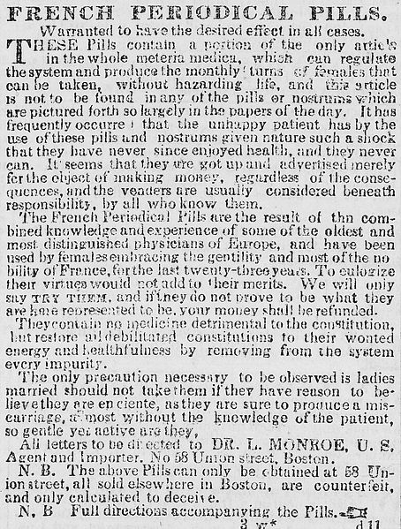
“FEMALE PILL” ADS IN 1870s
WARNINGS WERE THE AD

Slide 10

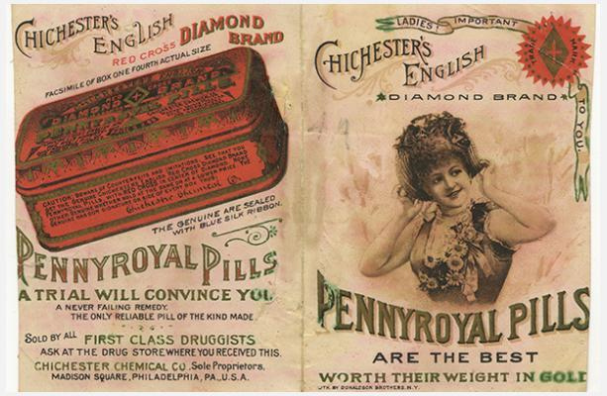
Notes:
‹#›

Slide 11



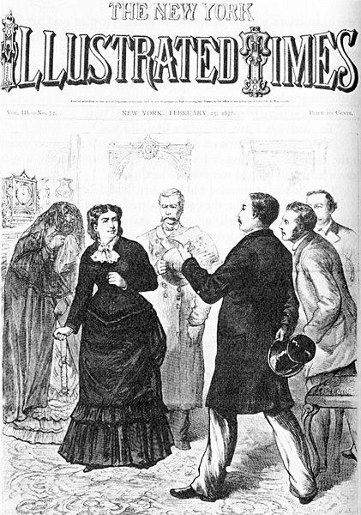
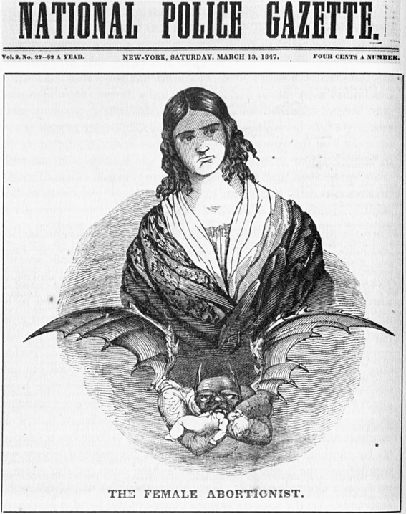
MADAME RESTELL
& RESTELLISM
Arrested in 1878
Kicked off a 150 year fight over abortion laws

Slide 12


19th Century
20th Century
BIRTH CONTROL HISTORY
  Some activism
  Constrained by prudish culture
  Lack of free speech
  Absence of birth control technology
  More secular
  Culture permissive
  Higher education for women
  Mass marketing of pill in 1960s
  Sex separated from reproduction

Slide 13
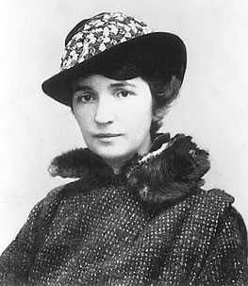
MARGARET SANGER
  “Women and the New Race
  Socialist
  Feminist
  Birth control pioneer

Slide 14
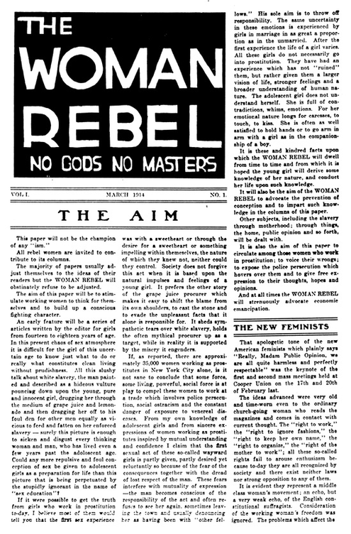


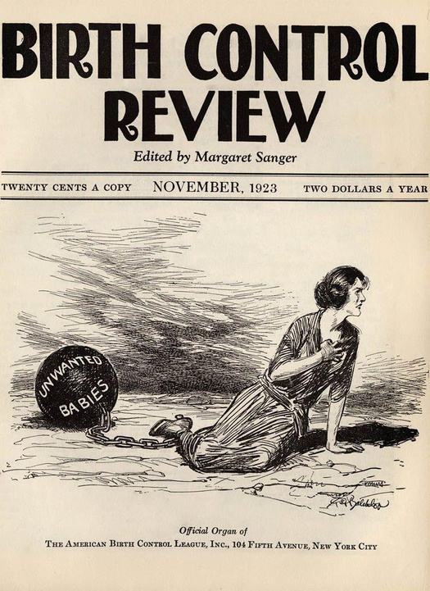

Notes:
‹#›

Slide 15
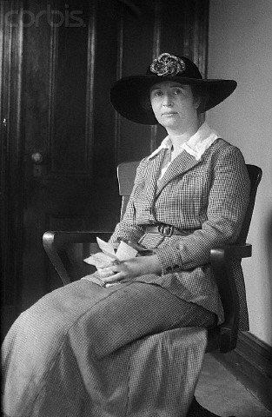
ETHEL BYRNE
  Sentenced 1917
    Working in birth control clinic
    1st female force fed political prisoner
  “I intend to go on a hunger strike. Furthermore, I do not intend to do a stroke of work at the institution.”

Slide 16



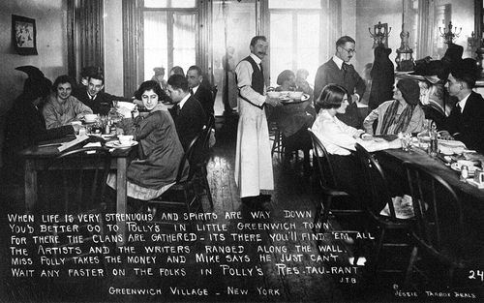
HETERODOXY 1912-1940
A CLUB FOR UNORTHODOX WOMEN
Charlotte Perkins Gilman, Inez Milholland, Elizabeth Gurley Flynn, Doris Stevens & Rose Schneiderman all attended Heterodoxy

Slide 17
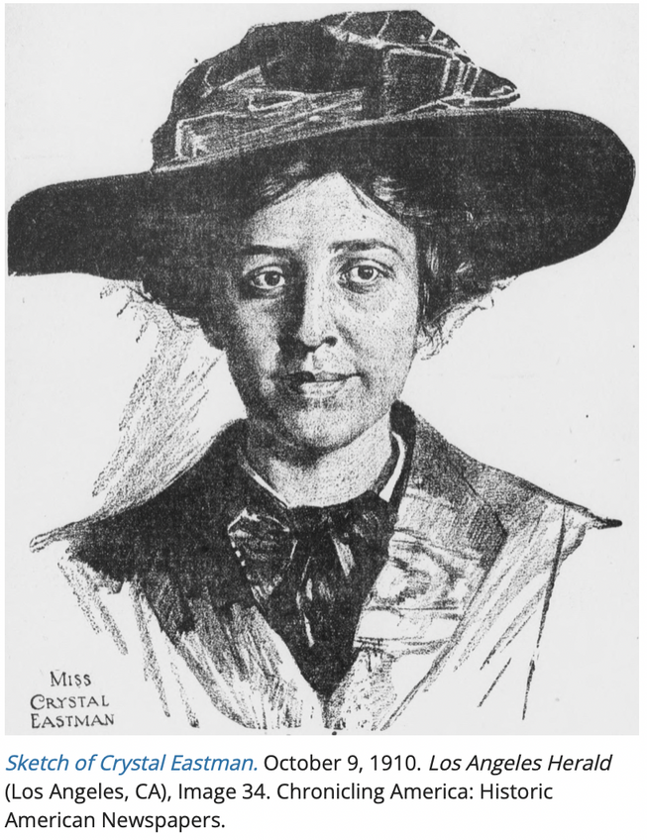
CRYSTAL EASTMAN
  NWP suffragist
  Co-author of the ERA
  Co-founder of the ACLU
Source: https://guides.loc.gov/chronicling-america-crystal-eastman

Slide 18
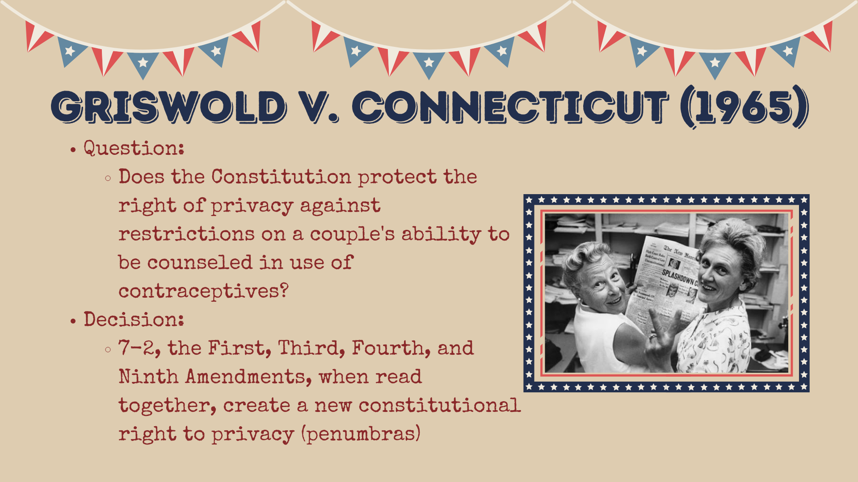

Slide 19
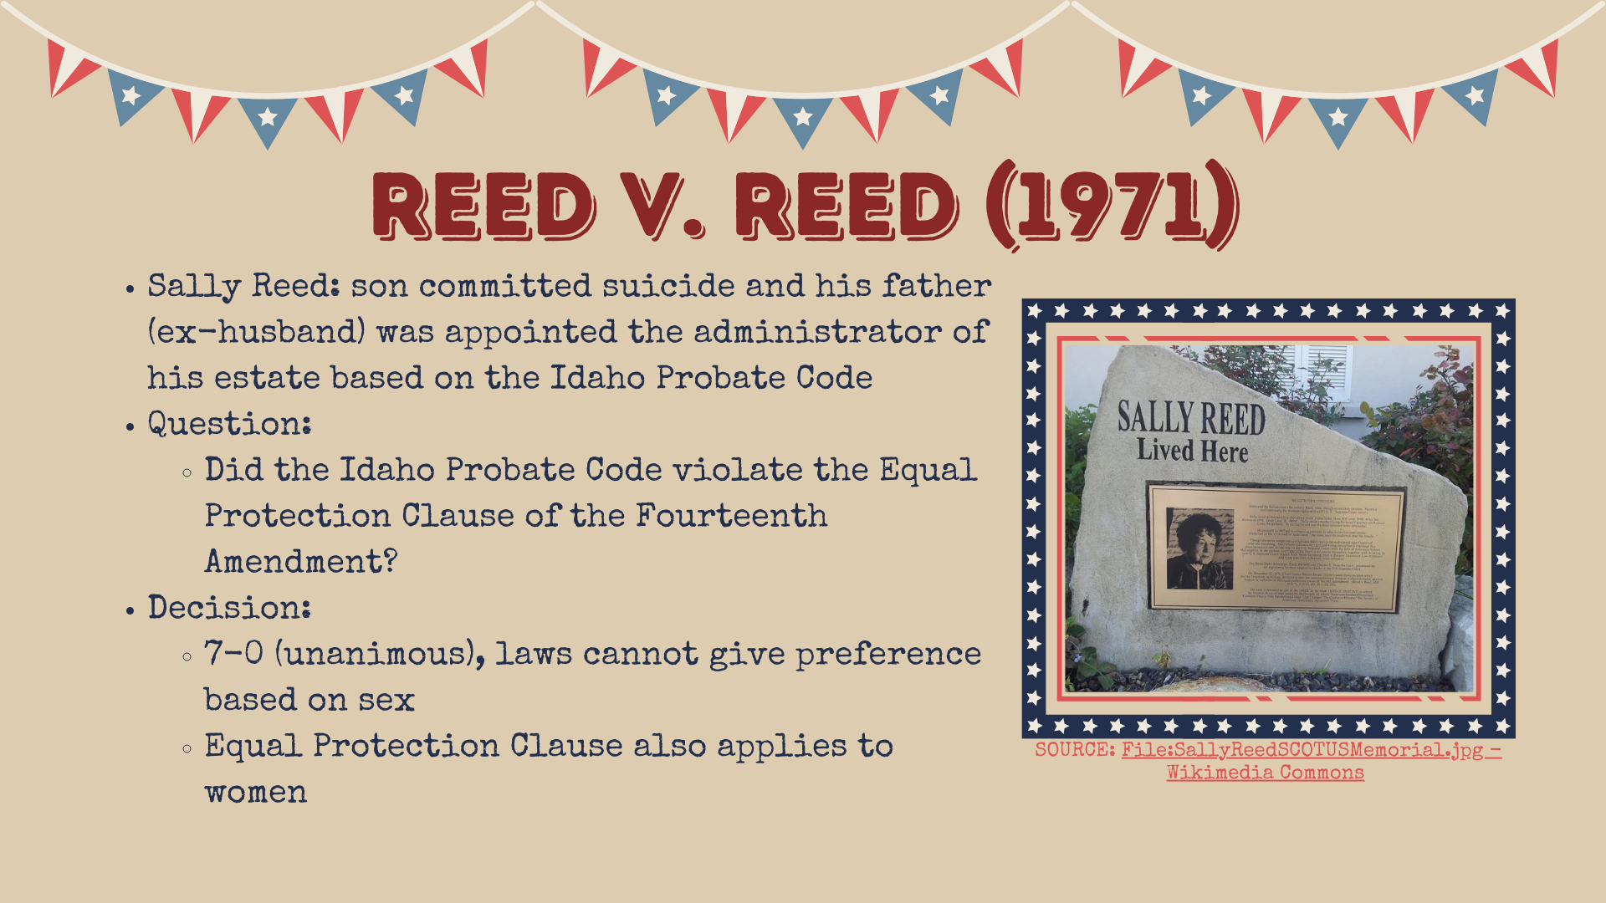

Slide 20
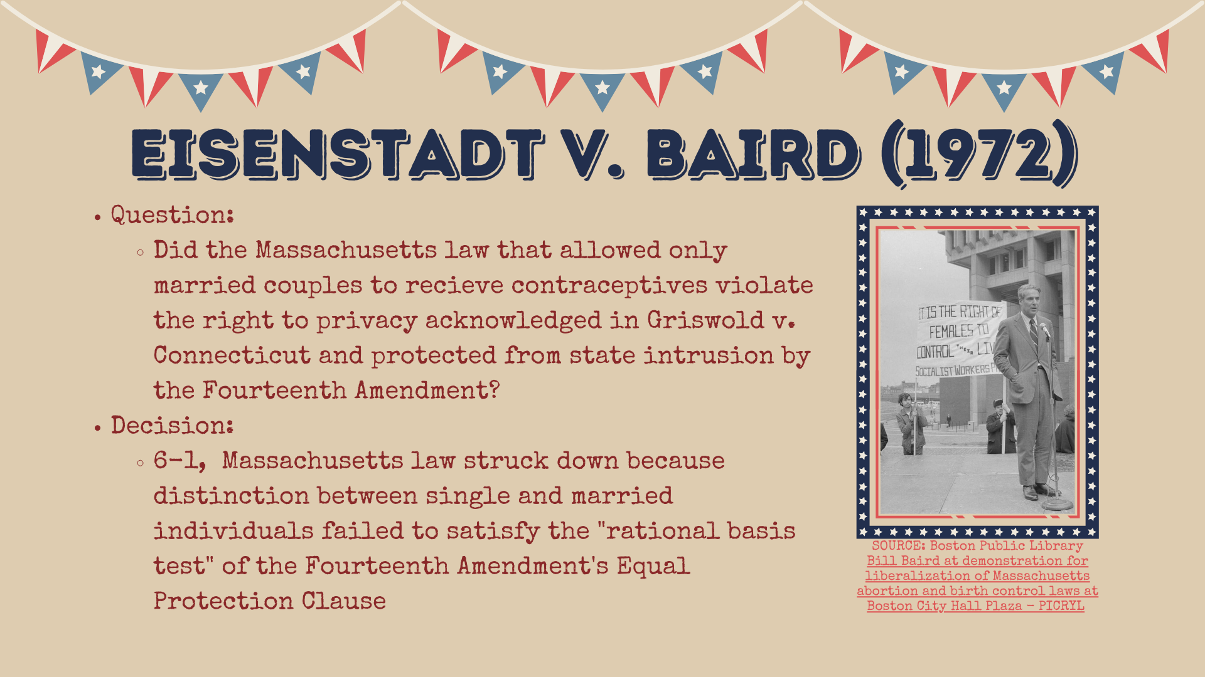

Slide 21
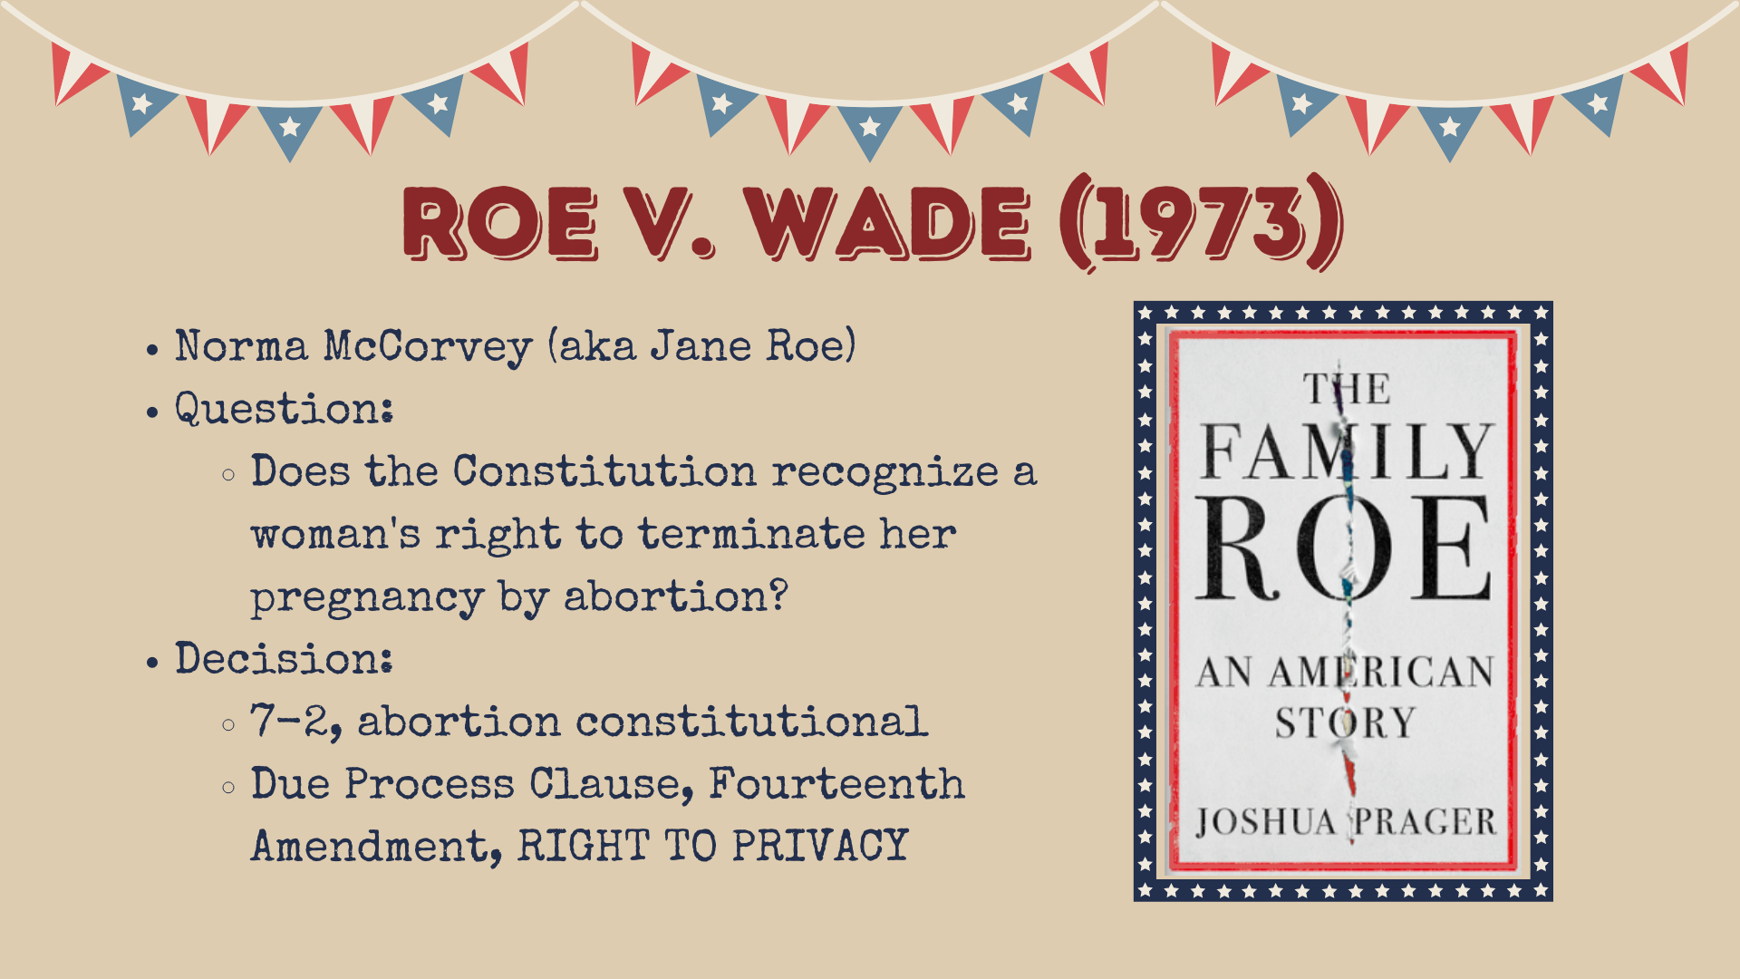

Slide 22
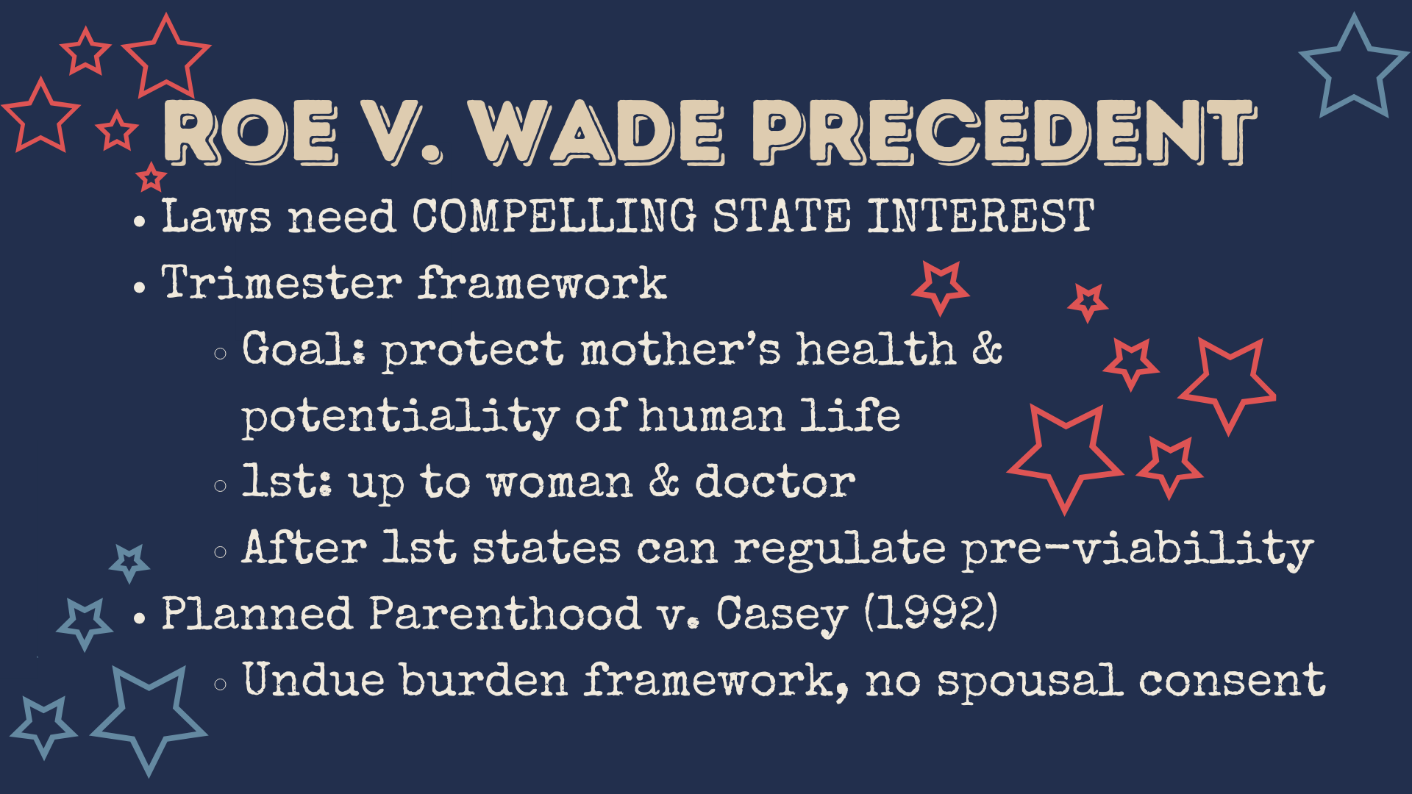
Notes:
‹#›

Slide 23


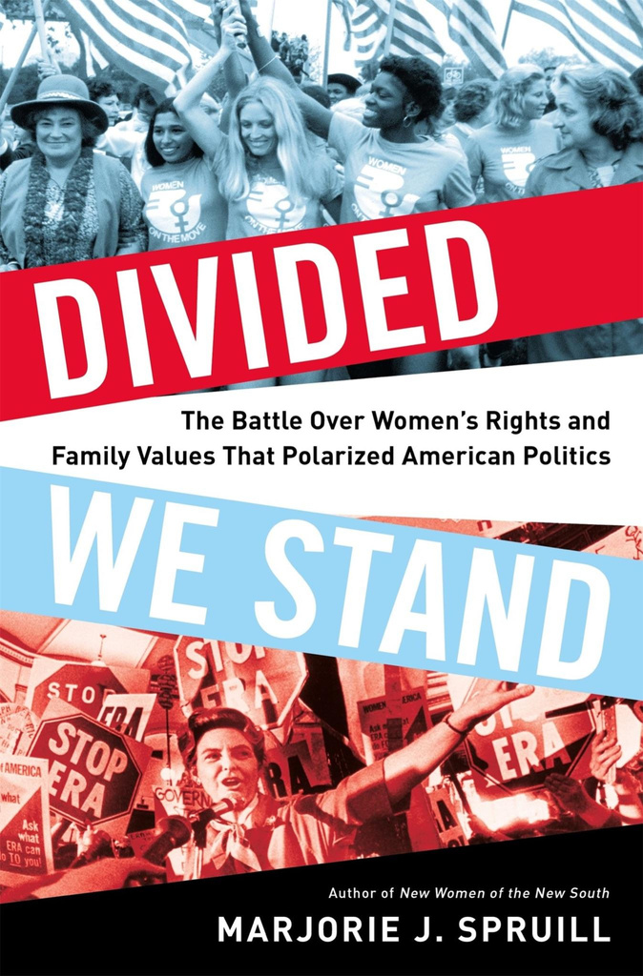

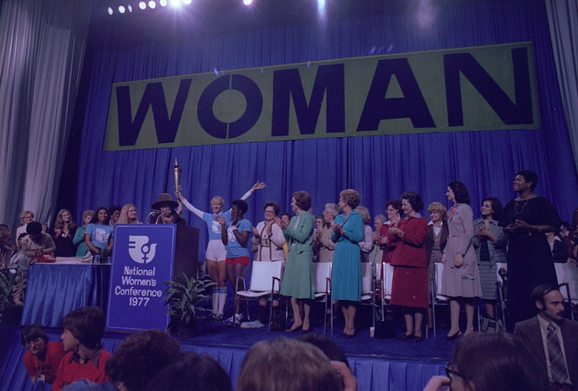
1977 HOUSTON WOMEN’S CONFERENCE
A TURNING POINT IN WOMEN’S POLITICAL HISTORY
Image from Wikipedia

Slide 24


GROWING CONSERVATISM
(1970s-1980s)
Reassertion of masculinity in the aftermath of the loss of the Vietnam War contributes to a restriction of women’s political rights

Slide 25


MODERN POLITICAL THINKERS
  Melissa Murray
    Racing Roe, Strict Scrutiny Podcast
  Leah Litman
    University of Michigan Law School
  Theresa S. Collett
    Natural family planning is the antidote to the harms of the sexual revolution | America Magazine
      “Like the early feminists, I refuse to accept that women must deny their fertility and slay their children in order to obtain equal access to the marketplace and public square.” Quoted in What Roe v. Wade Should Have Said edited by Jack M. Balkin, Page 194
  Erika Bachiochi
    What Makes a Fetus a Person

Slide 26


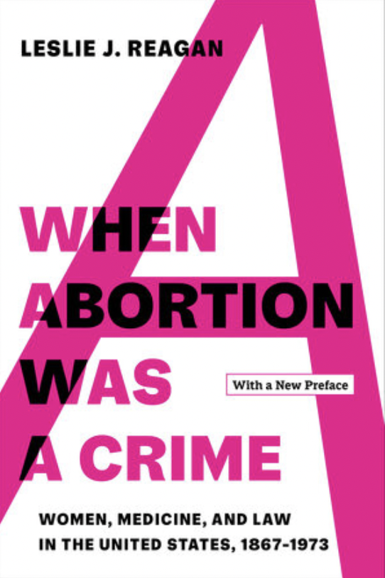


ECOMMENDED
EADING

Slide 27

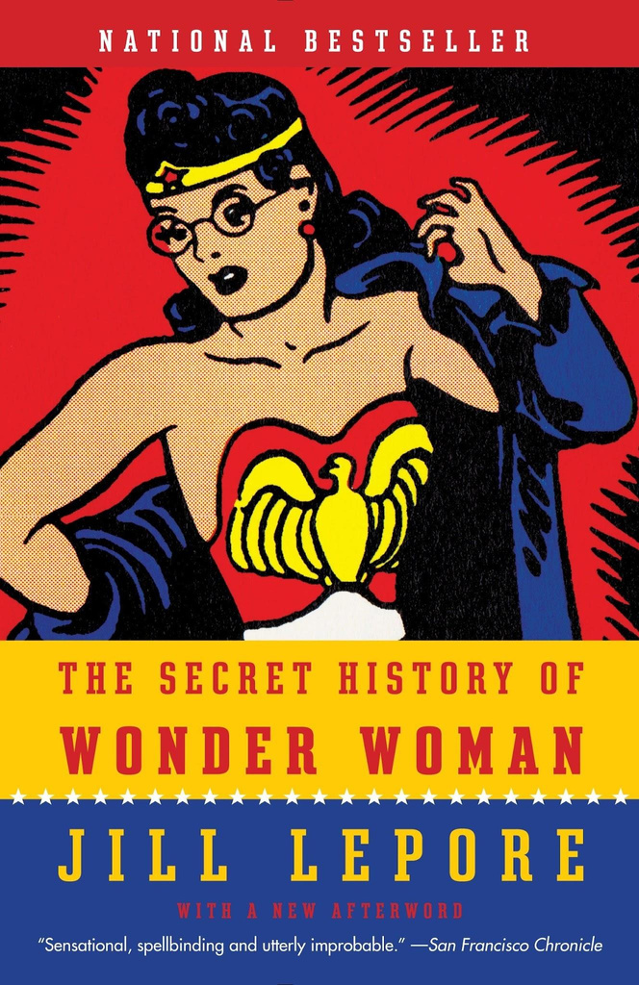


RECOMMENDED
READING
Notes:
‹#›

Slide 28
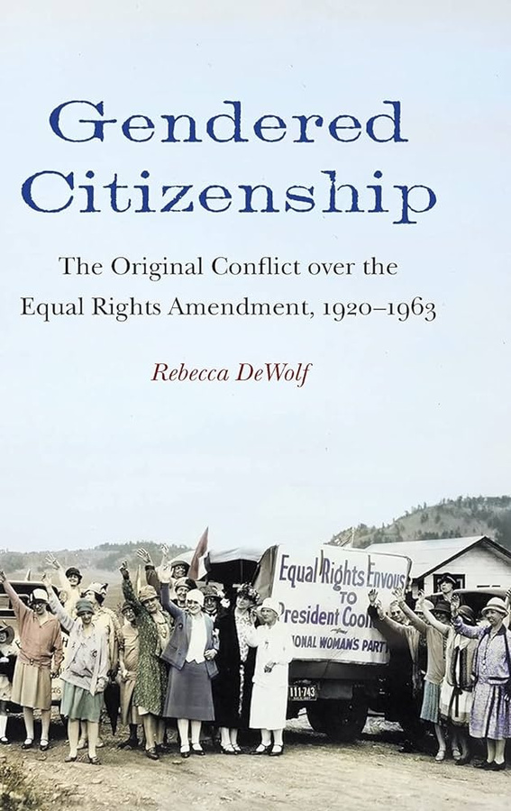

“Coverture...denoted a system of sex-specific marital duties in which wives were thought to owe their husbands services such as childbearing and homemaking. In return, the legal tradition presumed that husbands provided their wives with shelter and financial support.”
Rebecca DeWolf, Gendered Citizenship: The Original Conflict Over the Equal Rights Amendment, 1920-1963

Slide 29
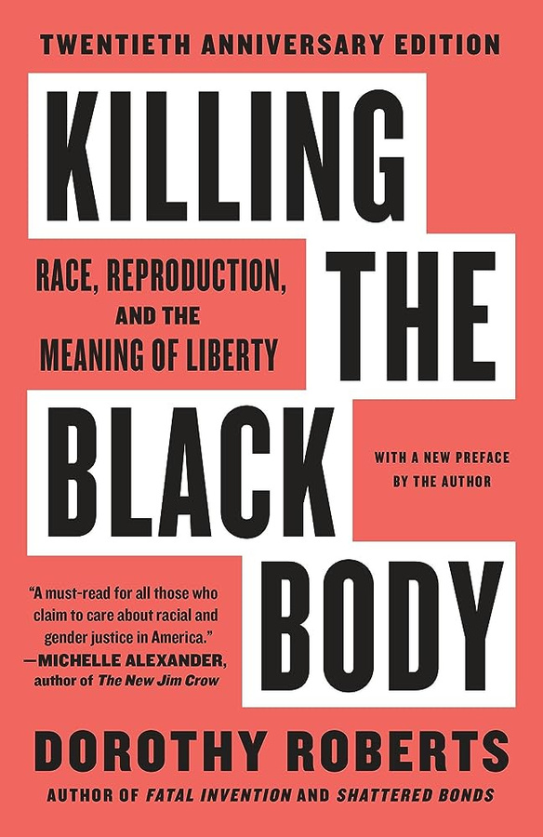

Enslaved women’s bodies were legally owned by enslavers & laid the groundwork for state sanctioned violence against women
“As far as I can tell, the relationship between Black women and their unborn children created by slavery is the first example of maternal-fetal conflict in American history”

Slide 30


“...Vietnam was not just a national security issue, but also a crisis of masculinity…The reassertion of white patriarchy was central to the new “family values” politics, and by the end of the 1970s, the defense of patriarchal power has emerged as an evangelical distinctive.”
Jesus and John Wayne: How White Evangelicals Corrupted a Faith and Fractured a Nation by Kristin Kobes Du Mez, page 12

Slide 31
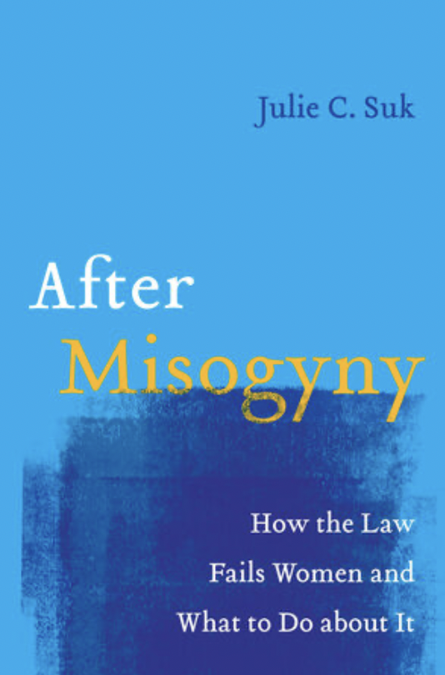

Julie Suk: Addressing men’s overentitlement & overempowerment protected by law
“...other constitutional democracies around the world liberalized abortion access by empowering the government to reduce the reproductive injustices women endured. Abortion bans enforce society’s entitlement to women’s sacrifices as childbearers for the public benefit of reproducing the community, without sufficient government restitution for this unjust enrichment. Reframing the misogyny of banning abortion through the lens of overentitlement opens up new legal paths for defending abortion access without the limiting privacy logic of Roe v. Wade.” Page 88
“...misogyny is best understood through the paradigm of overentitlement rather than through the paradigm of animus….combating misogyny, thus understood, requires the transformation of society’s foundational norms and baseline entitlements, which is why women in countries around the world have pursued constitutional change.” Page 22

Slide 32
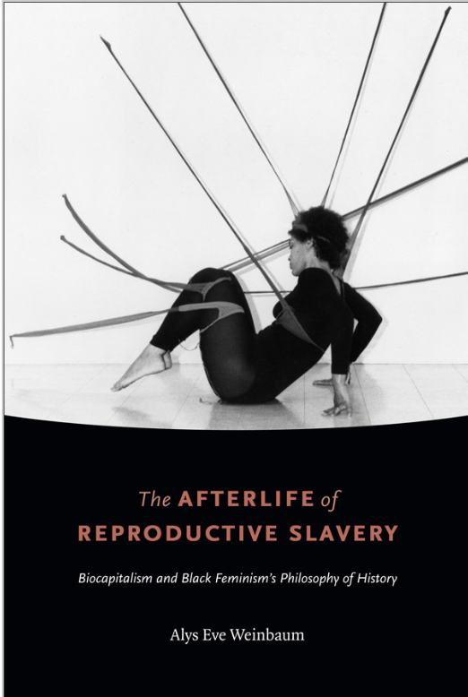

“...biocapitalism relies on reproduction as a racializing process that creates human biological commodities and itself functions as a commodity”

